Slide 1
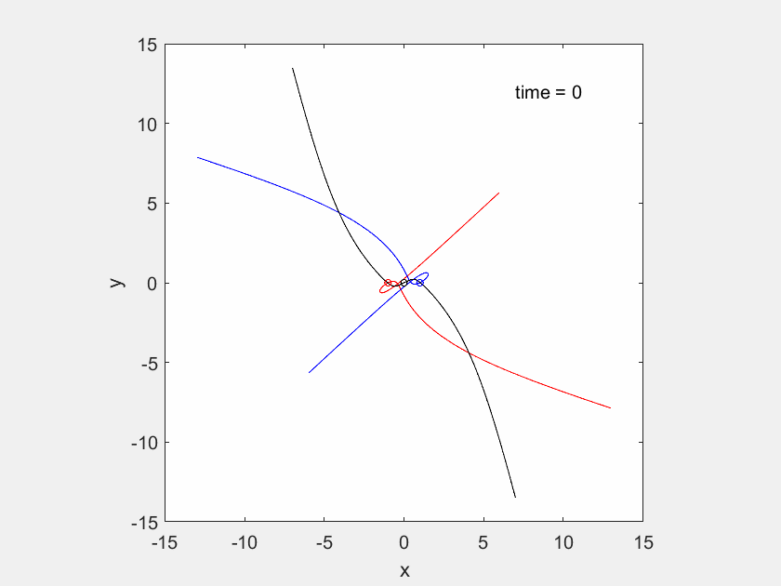
Free-fall periodic orbit (unstable)

Slide 2
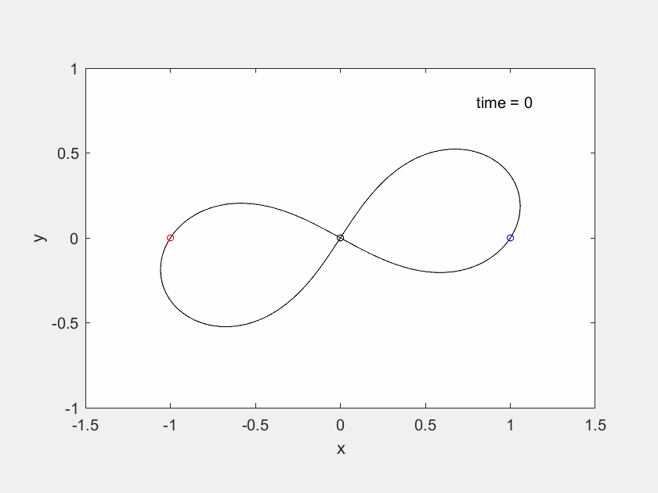
Famous figure-8 orbit (Moore, 1990) (stable)

Slide 3
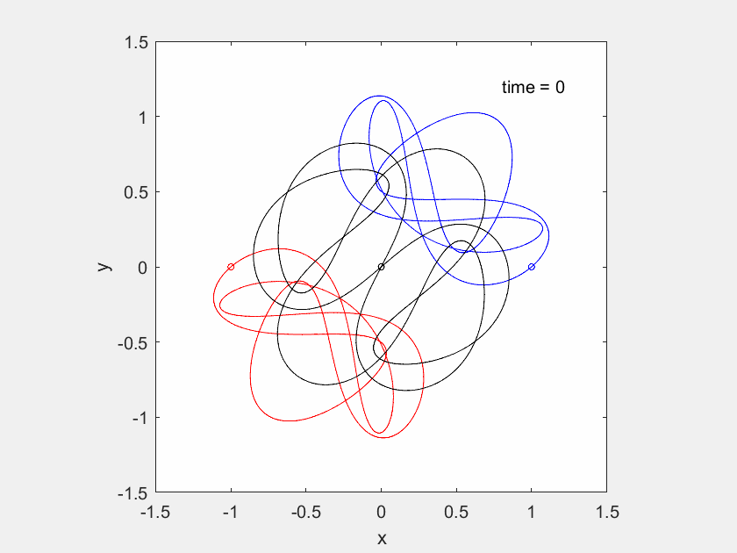
Moth I orbit (Suvakov and Dmitrasinovic, 2013) (stable)

Slide 4
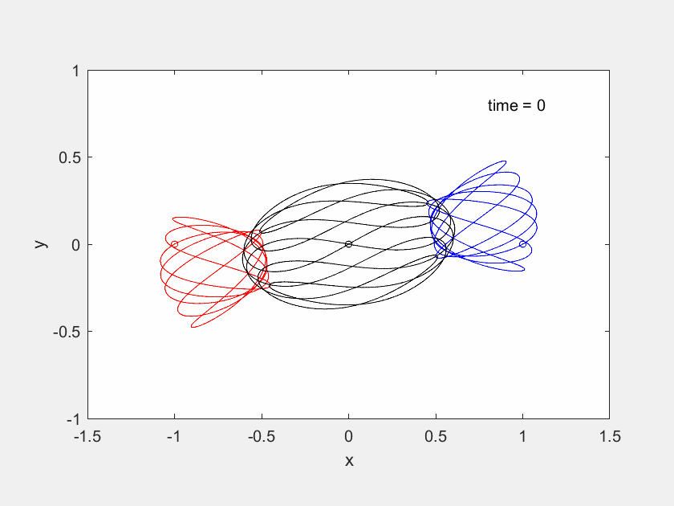
Butterfly III orbit (Suvakov and Dmitrasinovic, 2013) (stable)

